Slide 1


Steve Smyth GeoPose Summit 27 October 2025
GeoPose 1.x

Slide 2
Components and a Slight Scope Expansion
Things we learned
User feedback
Versions 1.1-1.4

Slide 3
GeoPose 1.x
Following the initial public review and subsequent publication of the GeoPose standard, we received valuable feedback across multiple areas. These insights were carefully analyzed and grouped into eight focused work packages—each centered around a specific theme—to guide future enhancements and ensure the standard continues to meet the needs of its growing user community.
Seven of the Work Packages reflect improvements based on feedback and implementation experience since publication of the OGC GeoPose 1.0 standard.
Work Package 8 is different. It aims to support implementation of systems that accept requests accompanied by images and respond with a corresponding GeoPose – Visual Positioning Systems (VPS).
Experience with VPS has brought out some of the fundamental aspects of poses and geolocation and we’ll now take a step back to consider them.

Slide 4
Stepping Back for a Moment
Pose is not only an established part of computer graphics but also wired into human visual perception.
We think in 3D.
We imagine spaces from a viewpoint.
Vision is the main portal to mental models of our surroundings.
Pose is a key part of human visual perception.
Pose can inform how we can build systems to mimic human visual perception.
Machine perception can adopt many of the computational formalisms of artificial neural networks to achieve practical implementations at normal human interaction speeds of tens of milliseconds.
Visual positioning is a basic perception task, and one of the original drivers for a GeoPose.

Slide 5
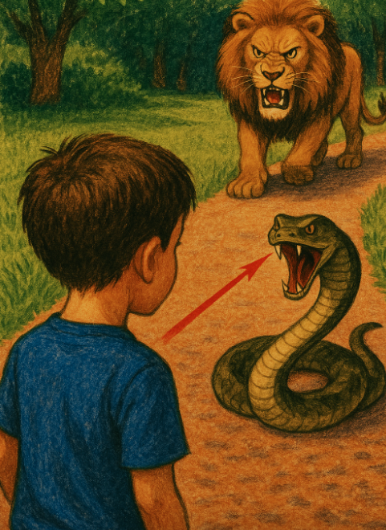
Survival
Many animals use vision to help them catch prey, find mates, or defend against danger. The ability to focus enables them to detect, locate, and orient themselves to food or danger. Evolution has wired attention into their brains.
We humans conceptualize this attention as perception of the location and orientation of ourselves or of tasty or scary things that we can see.
This visual attention to a perceived reward or threat we call “focus” or “gaze”.

Slide 6

Visual Perception
The human has both limited visual acuity and limited ability to think about objects in different reference frames at the same time.
Much of the time, the gaze jumps around in order to project the most important part of the scene on the densest area of retinal receptors. Our wiring blanks out the jumps and stitches the sensed views into a perception of the external environment, focussing attention on recognized objects.

Slide 7
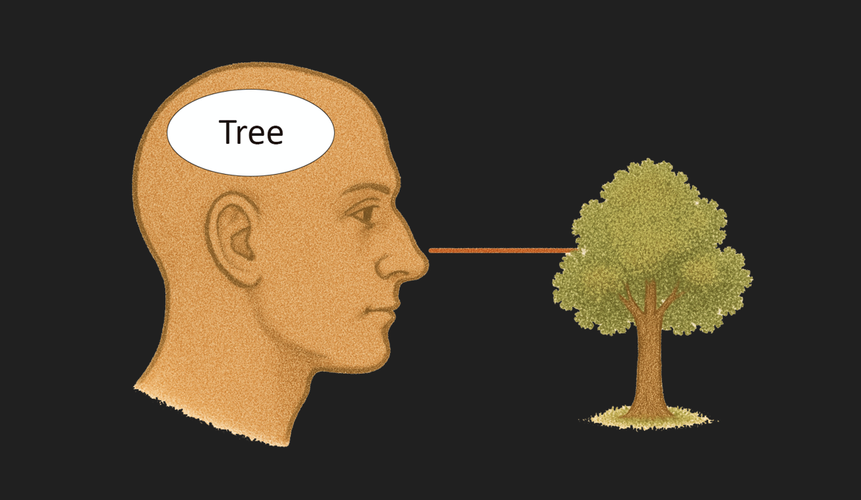
Visual Perception
Our visual perception produces a simplified internal representation, focussed on one Subject at a time.
We maintain the illusion that we are looking at many things simultaneously. But we are not.

Slide 8

Perception Is Selective
This Boy creates a simplified internal representation.
Lion - very dangerous
Snake - dangerous
Rabbit, Dog, Cat, Bird
Deer, Lawn, Bush
Footpath, Footpath
Car, Driver, Tree, Tree, Bush, Street
He attends to the Lion and may be aware of the Snake.

Slide 9

Attention
All of the sentient beings (Observers) perceive and are attending to the Boy (Subject). Each has established a reference frame, centred on their visual system and oriented toward the Boy. This relationship between Observer and Subject is a Pose. A Pose is a simple and direct way to express an attention relationship, visually perceived in the scene.
Example Pose description: The Lion is 3 m in front of the Boy, looking at him.

Slide 10

Attention and Pose
Here, the Rabbit (Observer) is attending to the Dog (Subject) while the Lion (Observer) is attending to the Rabbit (Subject). Some objects cannot pay attention (Tree) and some are controlled by an Observer (Car).
Each Observer can fully attend to only one detected Subject at a time. Posed attention limits global awareness but we normally do not realise this effect of focus.

Slide 11
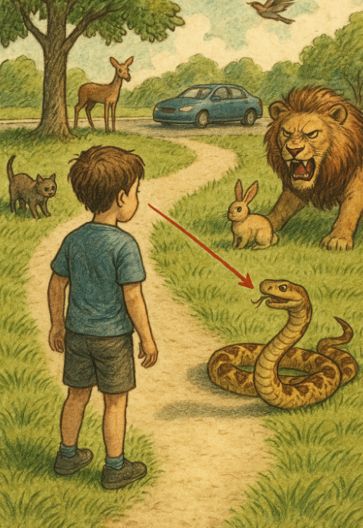
Translation-Orientation Model
Pose is an abstraction of the concept of an Observer’s attention to a visually detected Subject.
One way to express Pose is to start with a geometrical model.
Step 1:
Transform the “centre of visual perception” to a external 3D coordinate system (Translation).
Step 2:
Orient the coordinate system to the direction of attention (Orientation).

Slide 12
Adding Depth
A Pose by itself, defines a ray somewhere along which a Subject of interest lies.
Adding the distance along the ray, from Observer to Subject, or Depth, gives the Position of the Subject,
(Optional) Step 3:
Determine the distance along the direction of attention from the centre of visual perception to the Subject (Depth).
This step requires extra information that is often unavailable, at least at first glance.

Slide 13

Three Types of Pose
Observer Pose - the position and orientation of an imaging sensor or animal visual perception system.
Subject Pose - the orientation of a ray in the direction of a recognized viewed object (Subject) from the location of an Observer
Object Pose - the position and orientation of an object. Not every semantic type has an orientation independent of an Observer. A tree, for example.

Slide 14
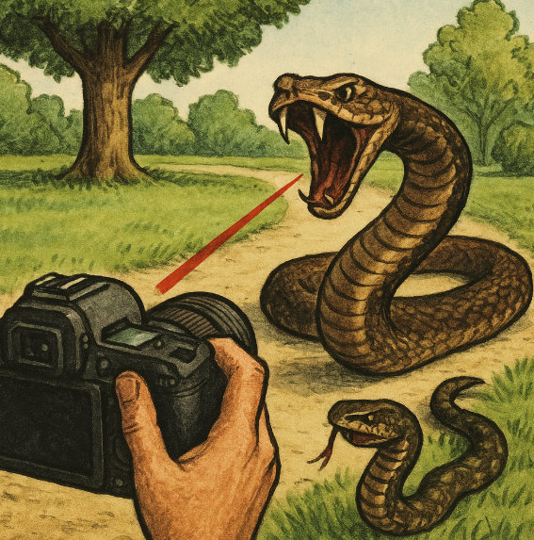
Observer Poses
An Observer Pose is defined by the position of a visual system centre or an imaging sensor’s centre and the Orientation or direction of view.
Observer Poses are independent of the environment. They do require some natural orientation of the Observer. The ocean or a tree are examples that do not. They do not have an Observer Pose.

Slide 15

Subject Poses
A Subject Pose is defined by the position of a detected object with respect to a visual system’s Orientation or direction of view.
In this scene, the centre of the visual system is in the Car and oriented toward the Boy. There are other detected objects in the scene (Bench, Bird, Tree…) that have the same centre but a different orientation. Those different orientations define a set of Subject Poses.

Slide 16
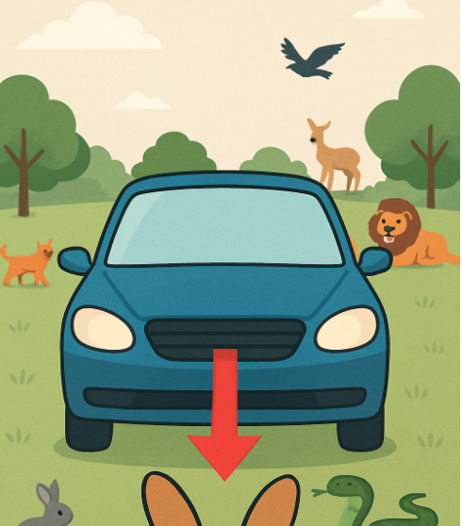
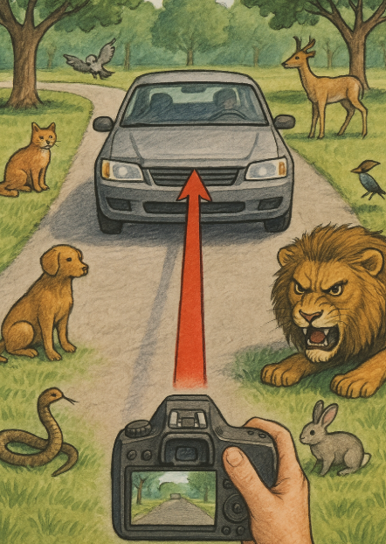
(Detected) Object Poses
Objects have different semantic types when perceived by humans or detected by neural network models. Some semantic types have a natural structure that gives them both position and orientation - a natural or intrinsic Pose.
If an Observer can detect the natural Pose of an object (left car) while the Observer has a view of the object (right car) as a Subject, the object will have two different Poses at the same time.

Slide 17
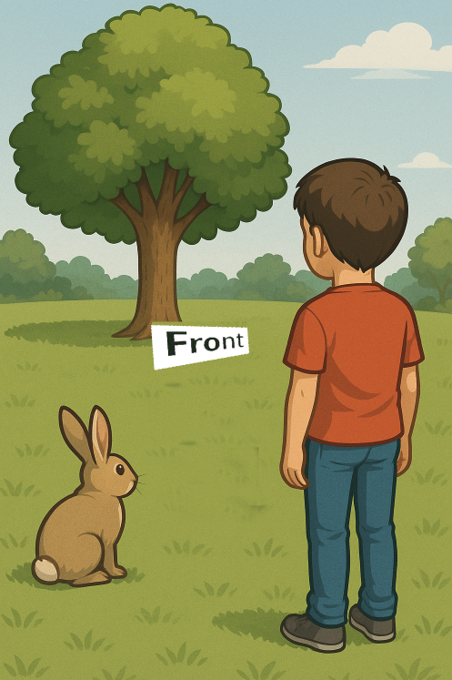
(Induced) Object Poses
Some semantic types do not have a natural structure that enables them to have a corresponding natural or intrinsic Pose.
For example, a Tree or a Rock does not have a Pose.
An Observer can induce an Orientation, based on the direction toward the observer. This induced Object Pose is only meaningful when the Observer position is also specified.

Slide 18
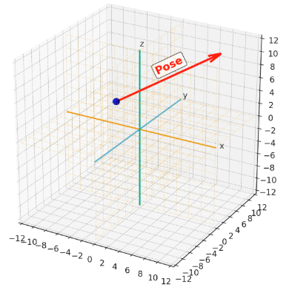
Representing a Pose
Poses have an origin and a direction. You can represent a Pose as a unit vector in a 3D (Euclidean) space.
In practice, a Pose may have additional properties:
The type of Pose - Observer, Subject, or Object.
One or more depths.
An associated uncertainty.
A time.
An identifier.

Slide 19
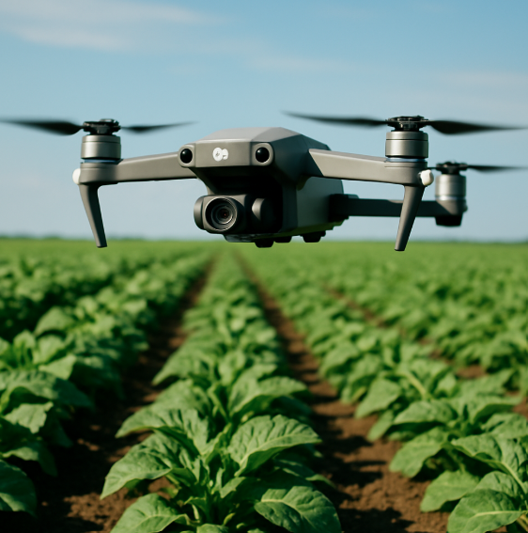
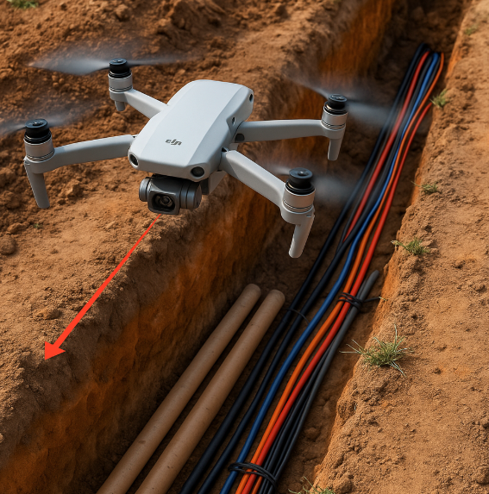
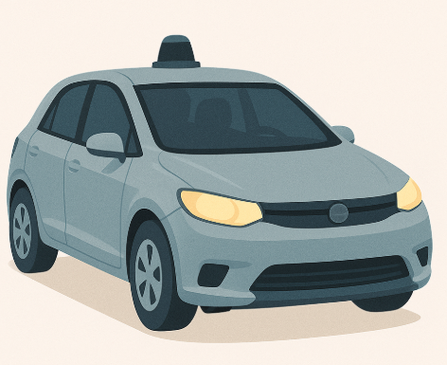
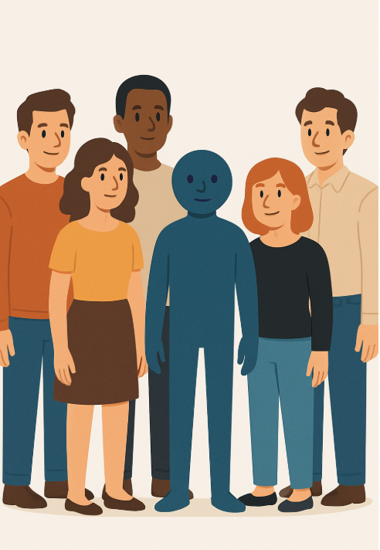
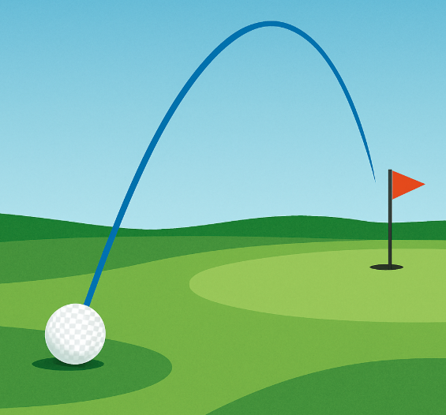
Using Poses
There is a wide range of applications. Most automate attention-intensive monitoring of human activities. The final presentation in this series covers applications that fall within the domain of artificial perception:
Surveillance, Reconnaissance, and Navigation
Collision Avoidance and Threat Prediction
Crop Inspection
Autonomous Vehicles
Environmental Inventory and Monitoring
Tracking
Privacy Protection - Avatar Substitution

Slide 20
Back to Now
We can separate the new things in GeoPose 1.x into four categories
Standards formalities: separating concepts and implementations
Expanded scope
Attention to feedback and experience with v1.0
Supporting the VPS thread of machine perception
The first is not very interesting for implementers, so we will not spend time there.
The remaining three relate back to the human origin of pose and the value of tying a reference frame to an Earth coordinate system.
The updates are organized as work packages, mostly driven by use case requirements and application domains.

Slide 21
OGC GeoPose 1.0 Standardization Targets
The Basic-YPR and Basic-Quaternion targets are simple and concise – no options. They satisfy most use case requirements and assume a local tangent plane east north up (LTP-ENU) frame derived from WGS84 (EPSG 4979).
An Advanced GeoPose target supports more complex use cases where the outer geographic reference frame is not LTP-ENU and/or a valid time is needed.
Composite:
The Chain GeoPose target provides additional flexibility with multiple intermediate frames or specific coordinate reference systems as needed.
The Frame Graph target supports the full structure need to represent networks of reference frames that arise with the use of multiple and linked location technologies.
The three (Time) Sequence targets support the packaging of fixed-length time series of GeoPoses and the payload data objects for open-ended GeoPose streams.
The standardization targets are independent. A minimum conforming implementation need only conform to the requirements of a single encoding of a single target.

Slide 22
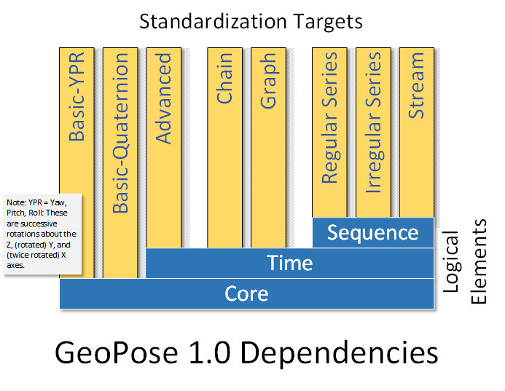

Slide 23
Expanded Scope
Individual concrete data objects for the exchange of anchored poses, each interpretable as a linked position and orientation tied to an externally-defined frame of reference, for example an Earth-centered, Earth-fixed geodetic spatial reference system. The linkage may be direct or through a chain of frame transformations.
Composite structures
Sequences grouping anchored poses in time series and delivered as a packaged sequence or unbounded stream.
Linked structures representing networks of reference frames, expressed as a graph where the nodes are frames and the edges are transformations between the linked frames. Chains are intentionally distinguished as a special type of graph because they are a common special case with a simpler representation.
Out (in v1.0):
API
Transports
Uncertainty: accuracy, precision [1.x WP5]
Other kinematic or dynamical properties: velocity, acceleration, angular velocity
Camera model [part of 1.x WP8]
Metadata
Security

Slide 24
The Work Packages
The eight Work Packages are described in a shared Google Doc .
The list is fixed in scope until the current 2-year development cycle is finished. Work Packages with either no leader or no progress are likely to be removed.
Let’s take a look at the WP table
And now dive into the details….

Slide 25
Components
(We have 25 proposed components in four groups. Review by looking a group diagram, then each component in sequence. Discussion embedded in process. About 1 minute of explanation per component.)
A component is a datatype or a class
Justified by a use case
Must be conceptually in scope
Needs a machine-readable schema – I am trying to make JSON-Schema do the job but I would not yet say that I am winning the battle to avoid starting with UML.
The values of a datatype or properties of a class need required ability to represent whatever it is that they communicate. So JSON Numbers are useless as a specification. I am experimenting with the JSON-Schema “format” property but the AI workers in my toolchain do not yet respect my wishes.
I hope that we have some discussion as we go through the list, from which I can collect your suggestions, corrections, or other contribution and publish as a reviced set of slides.
Components (Structural Data Units) were used in v1.0, but were not accompanied by requirements or conformance tests, hence not usable as standardadized elements outside of a full GeoPose structure. V1.1 will include the missing elements so that the components, such as a Position or YPR angles, may be used individually.

Slide 26
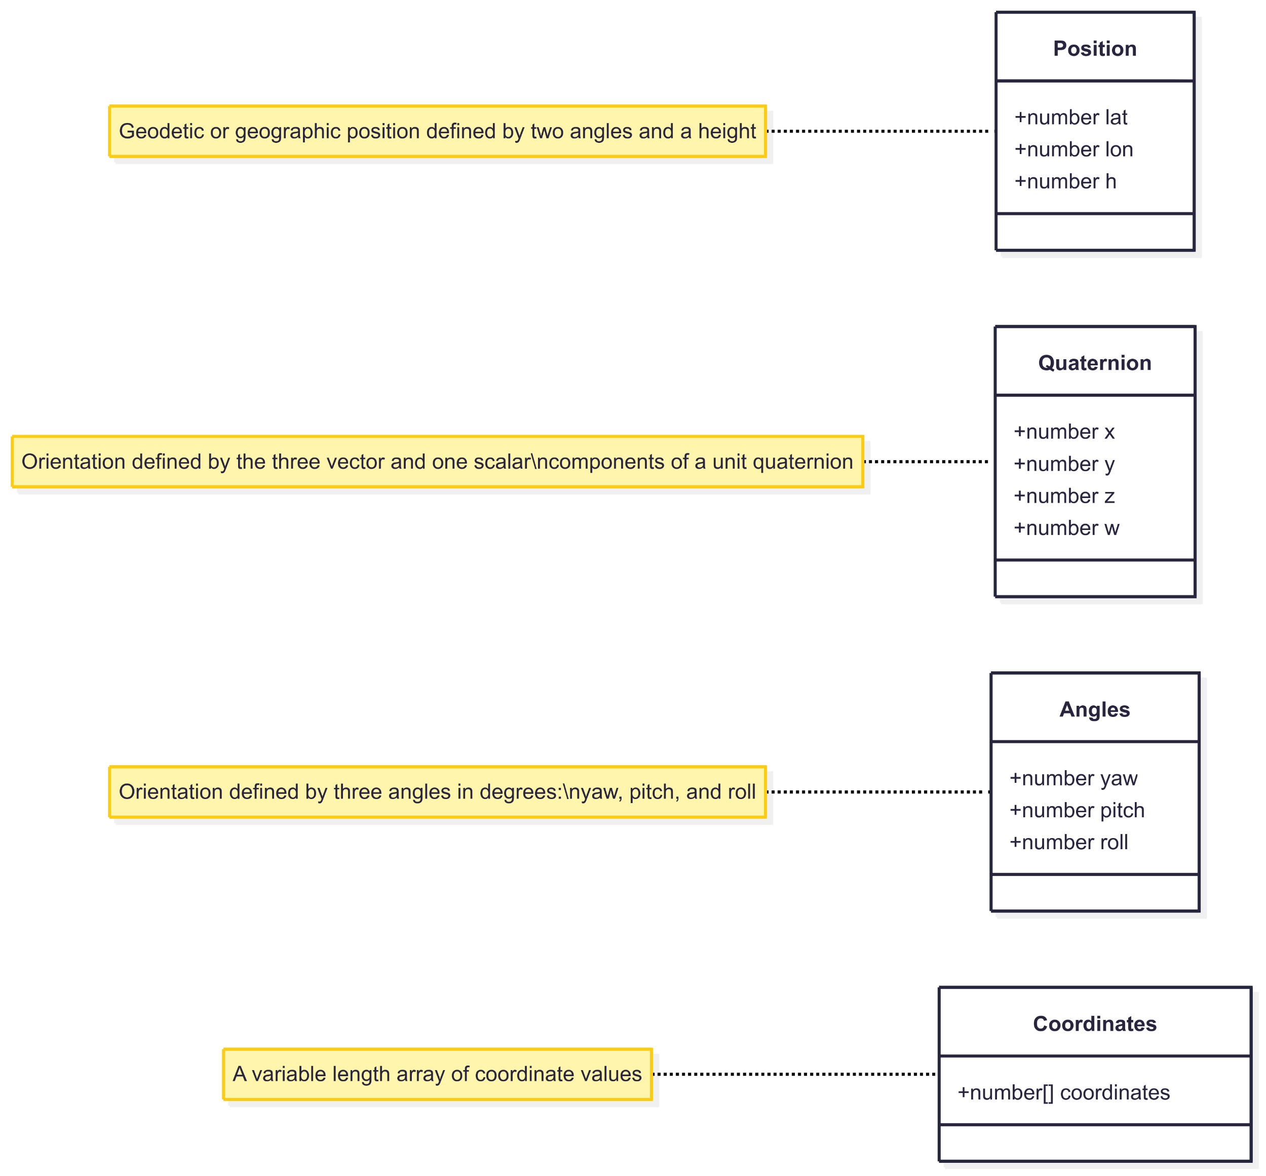
Core Components
2:20

Slide 27
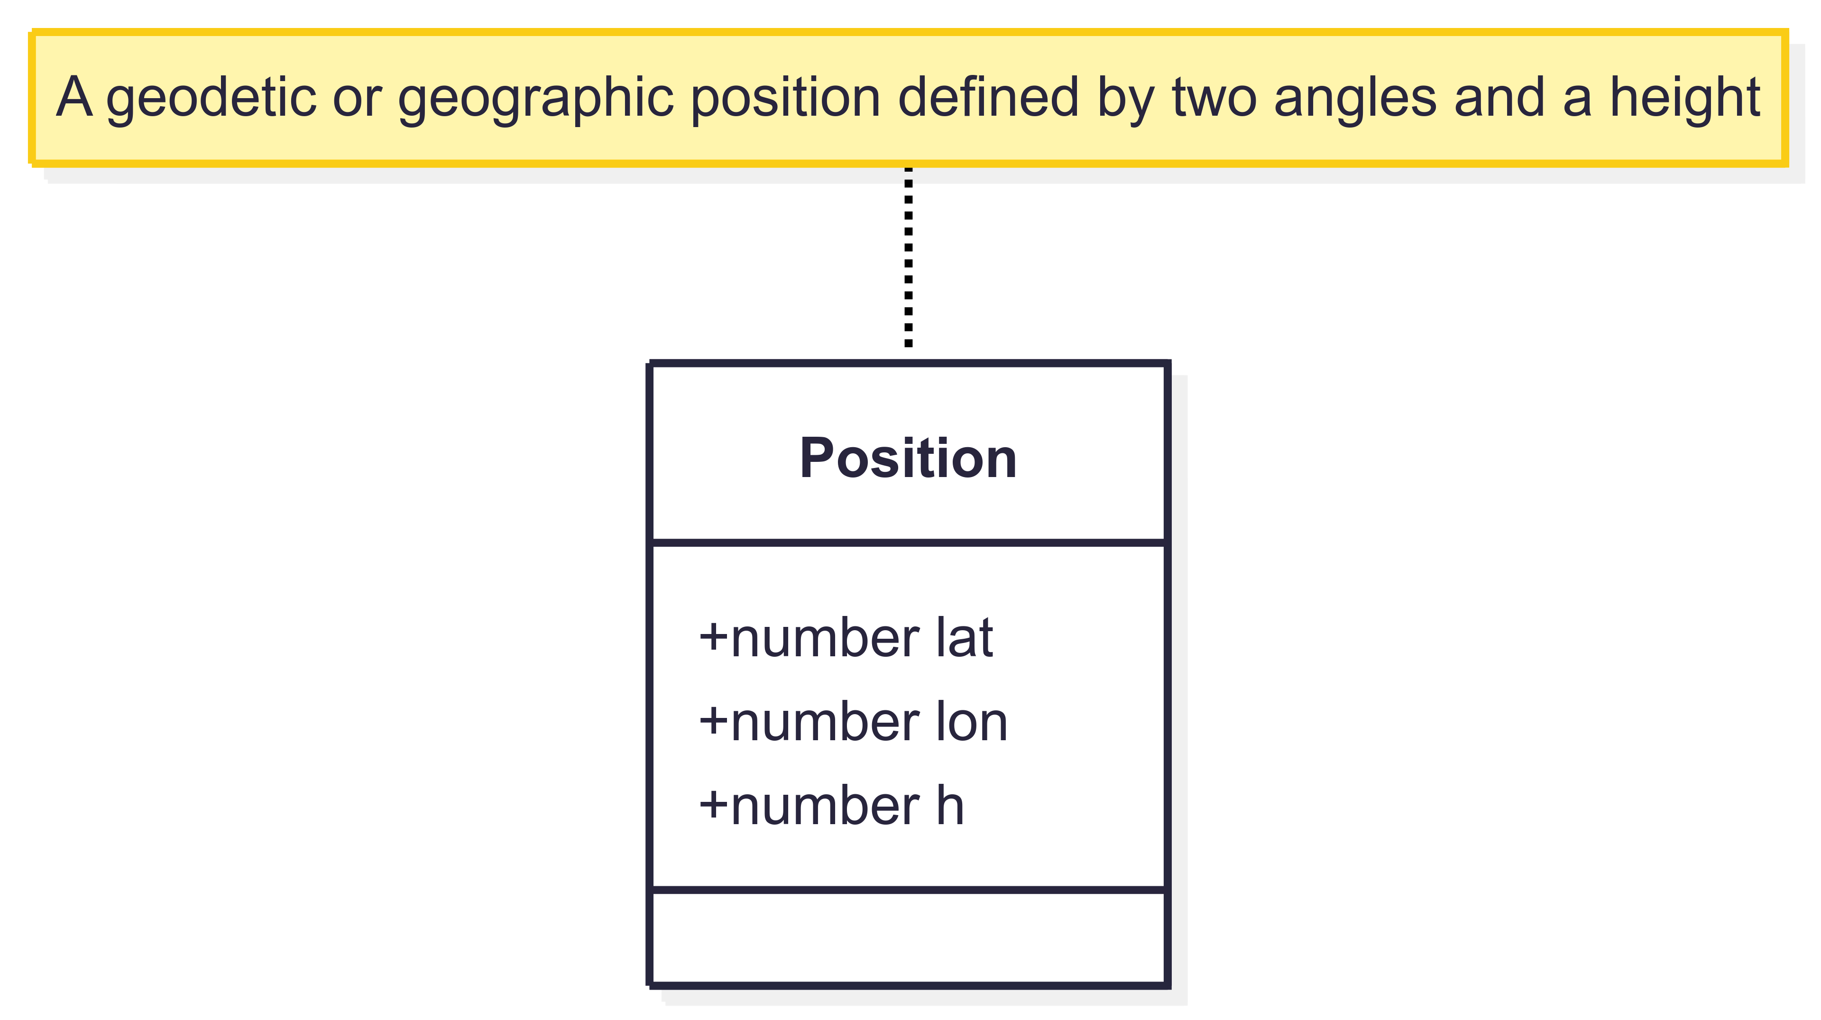
Core Components – Position

Slide 28
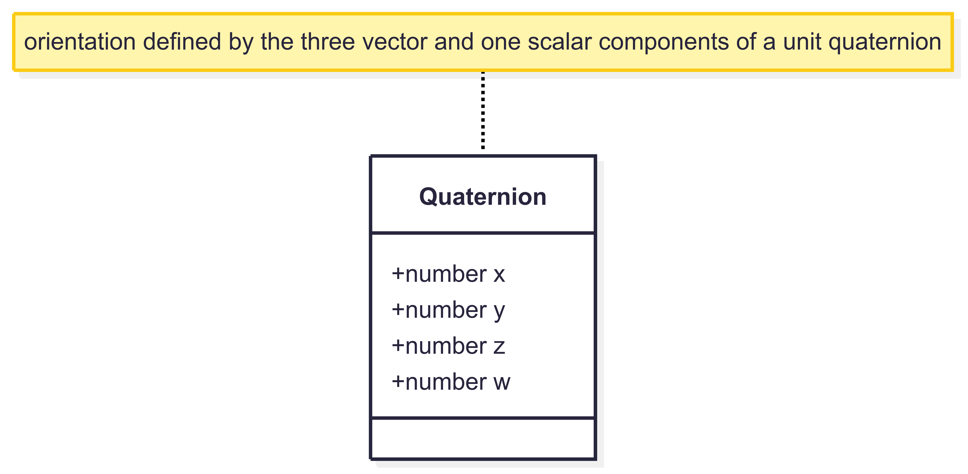
Core Components – Quaternion

Slide 29
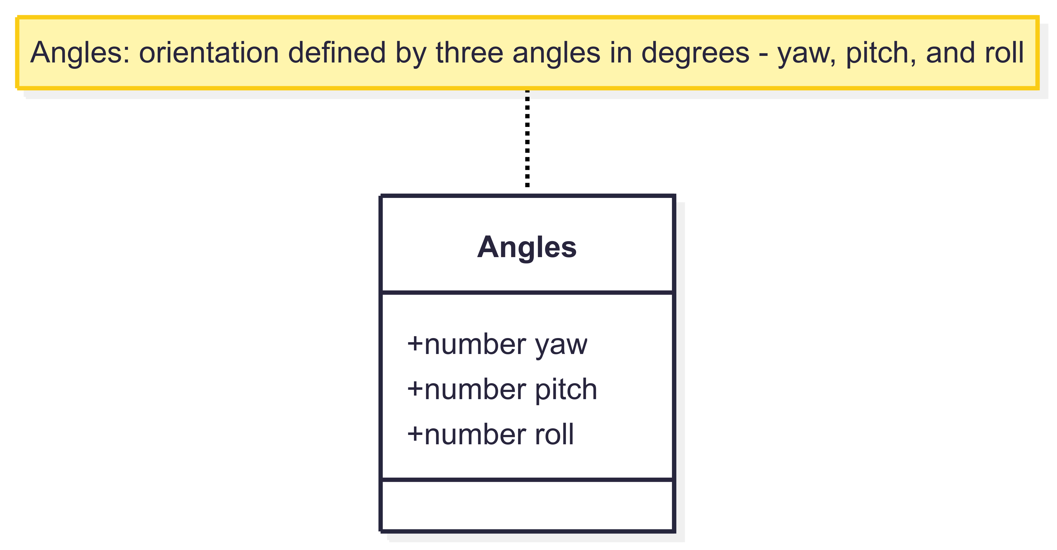
Core Components – Angles

Slide 30
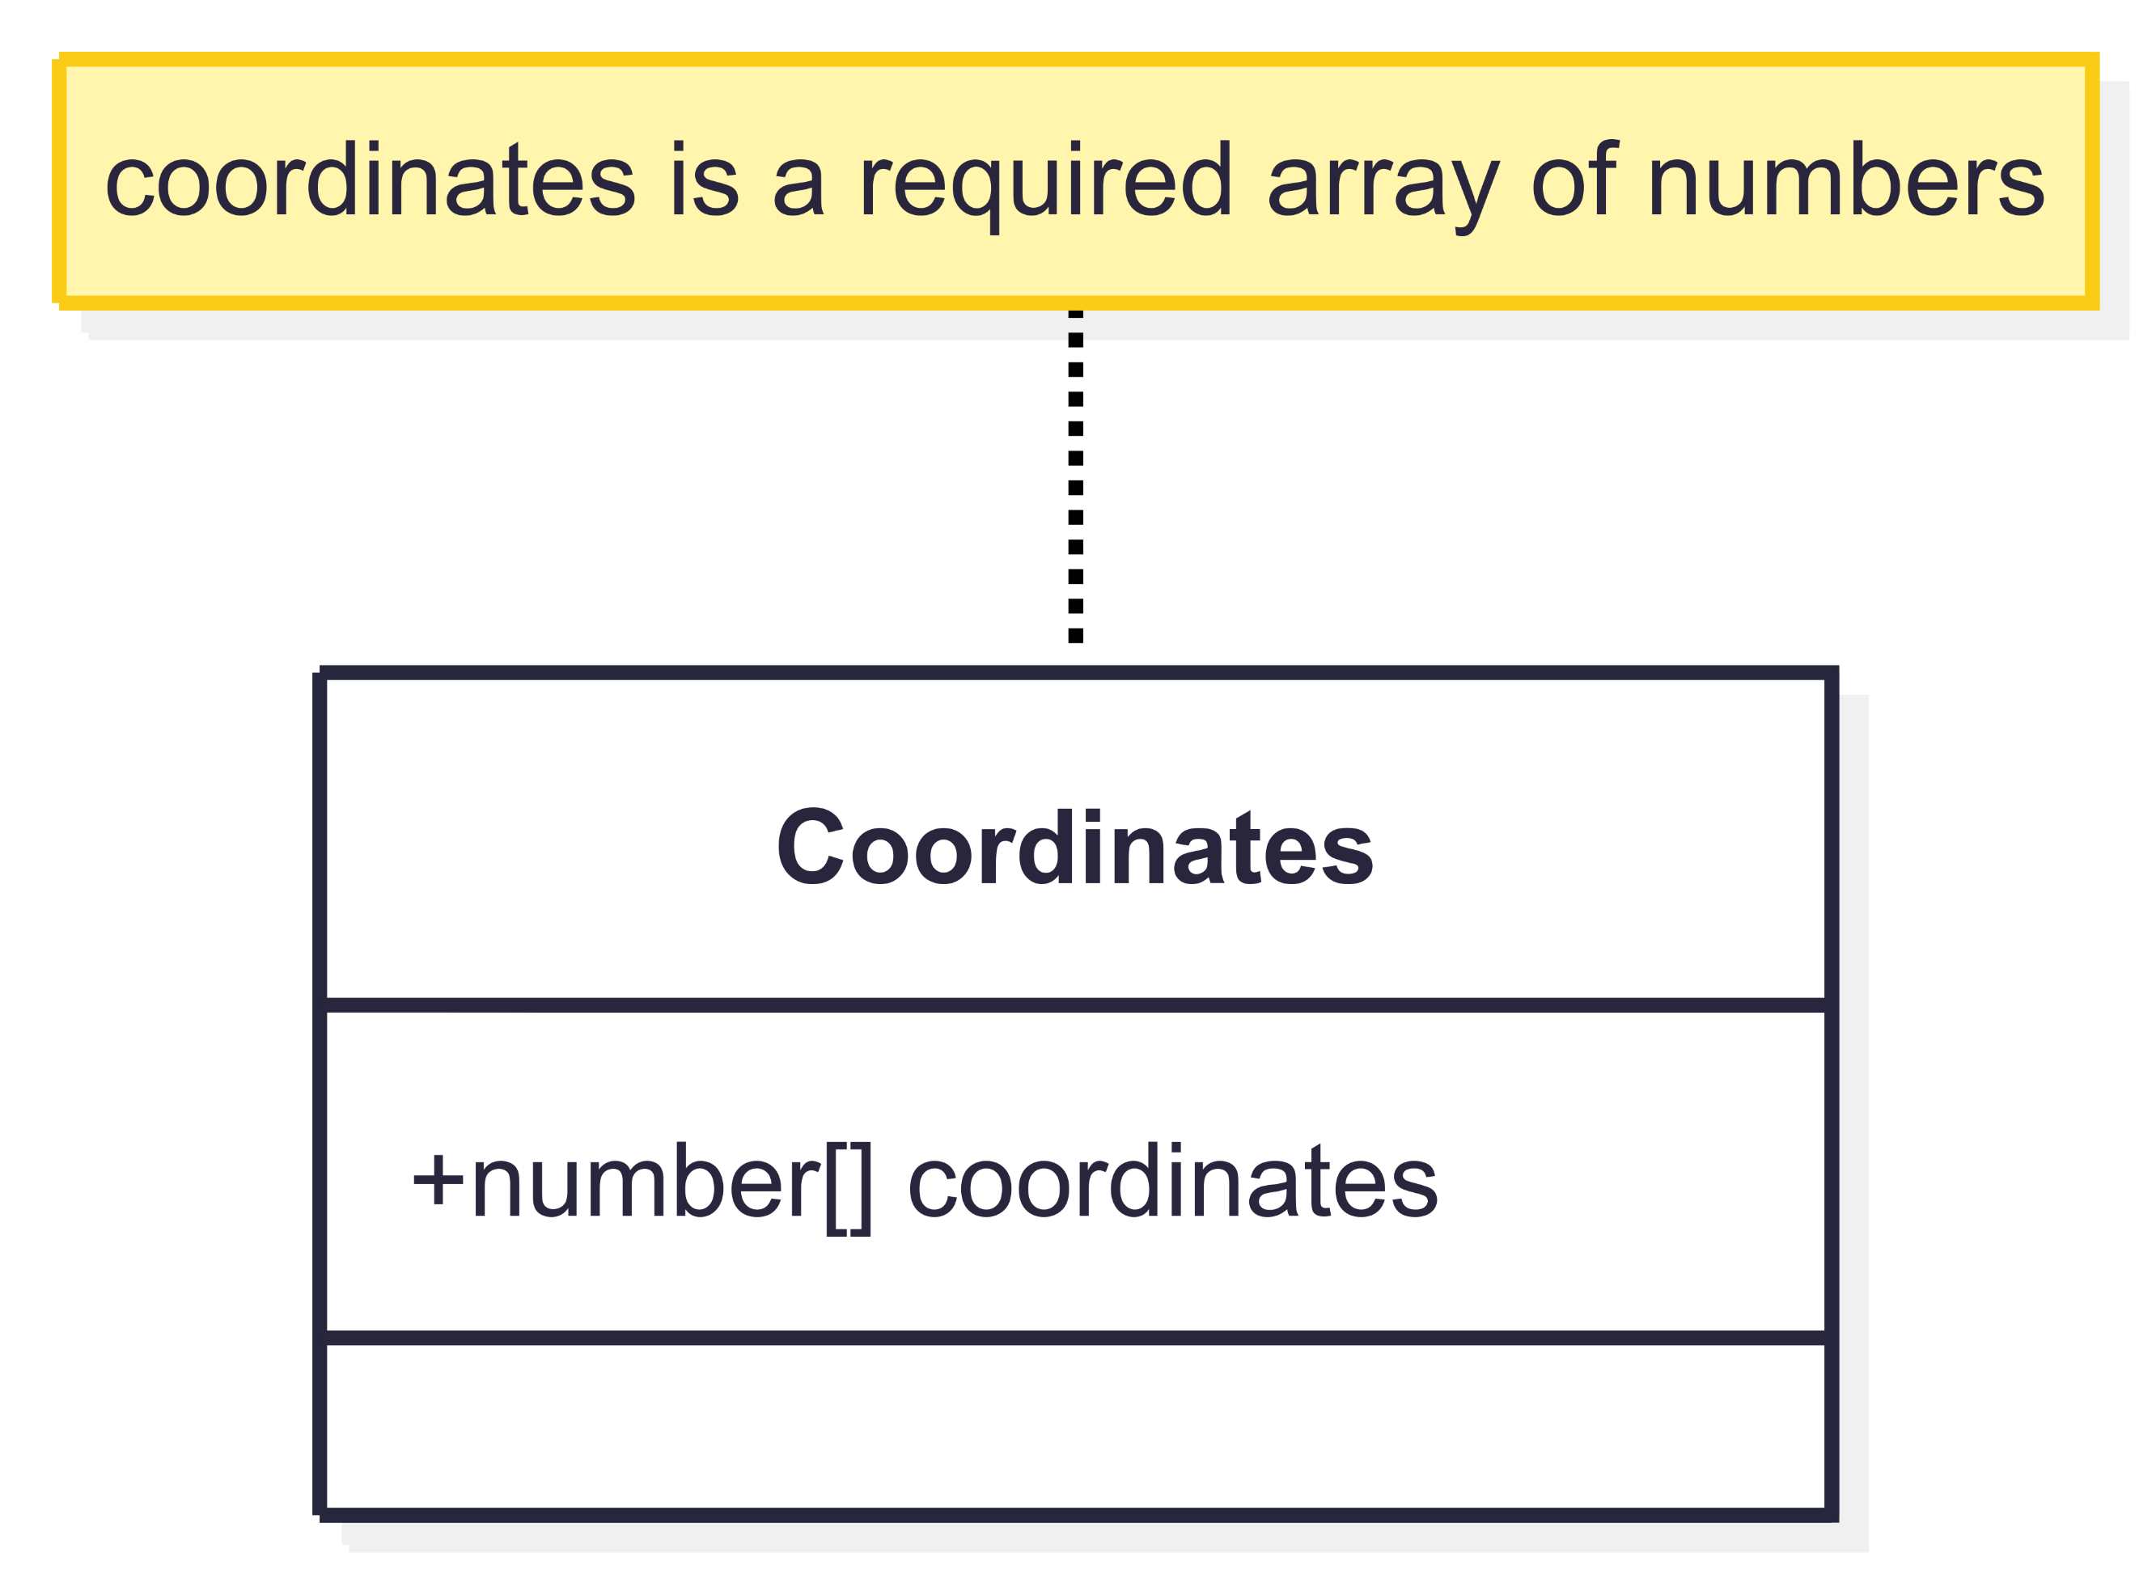
Core Components – Coordinates

Slide 31
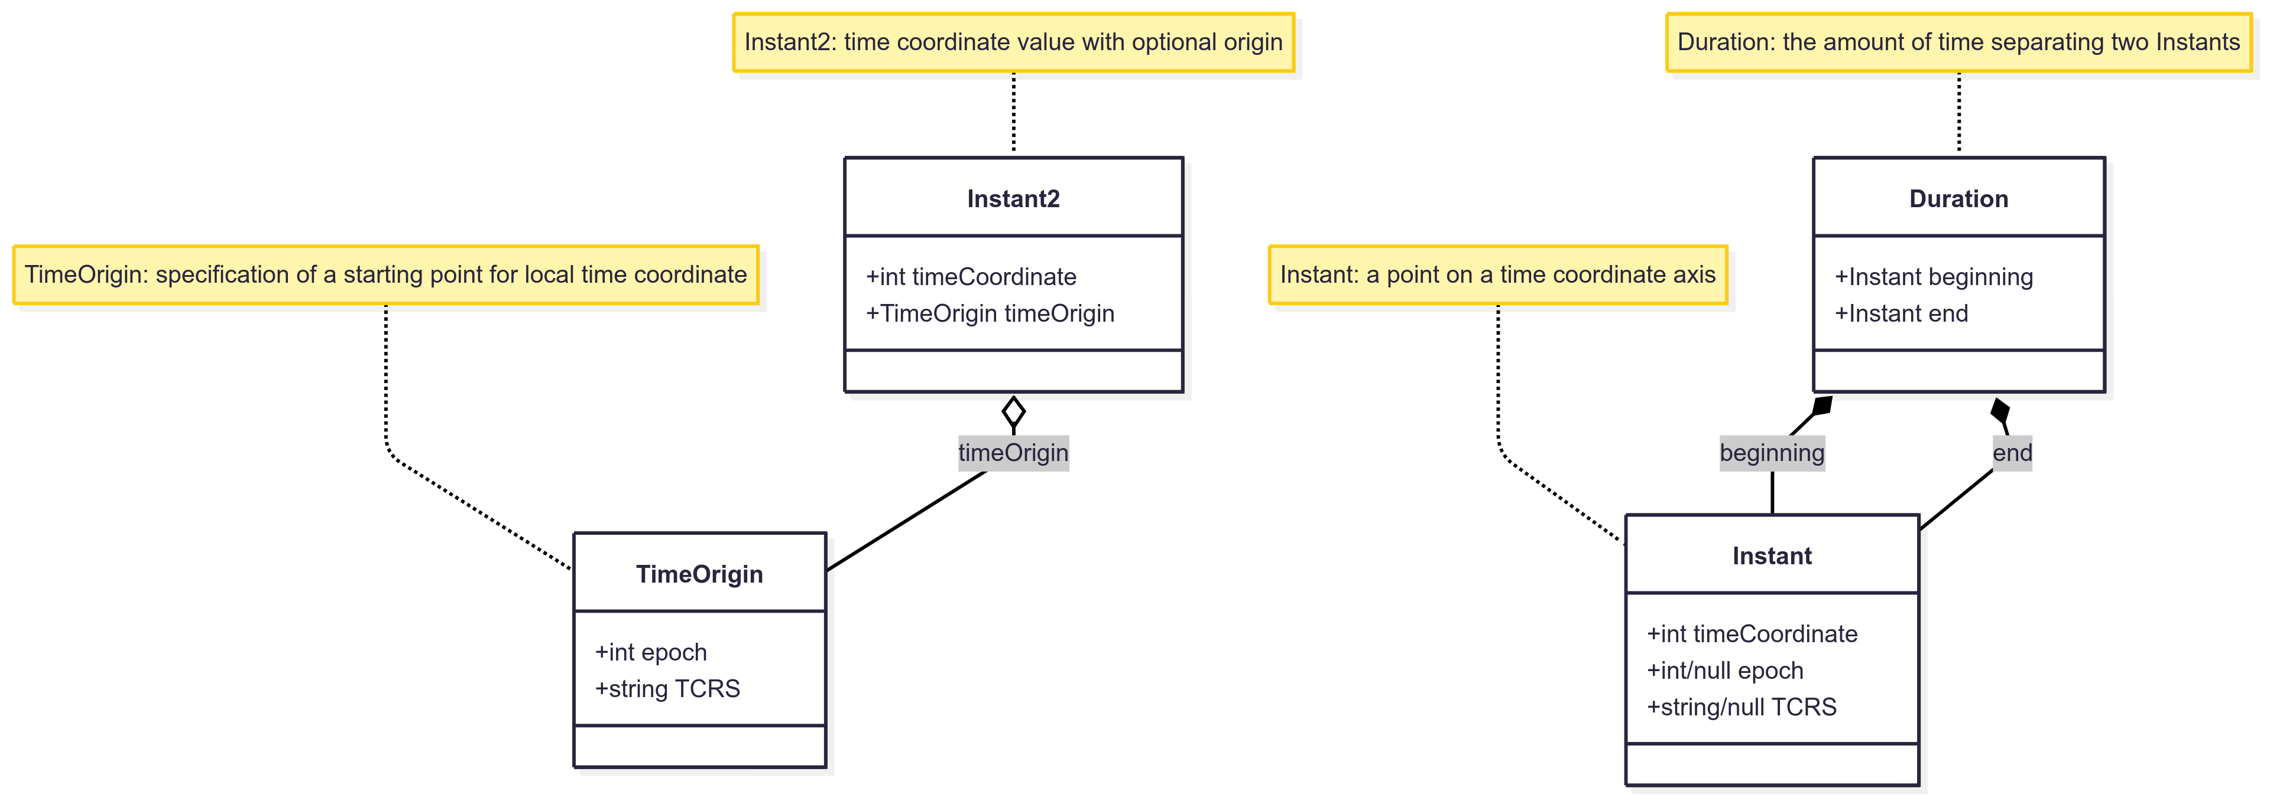



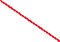
Time Coordinate Components
2:30

Slide 32
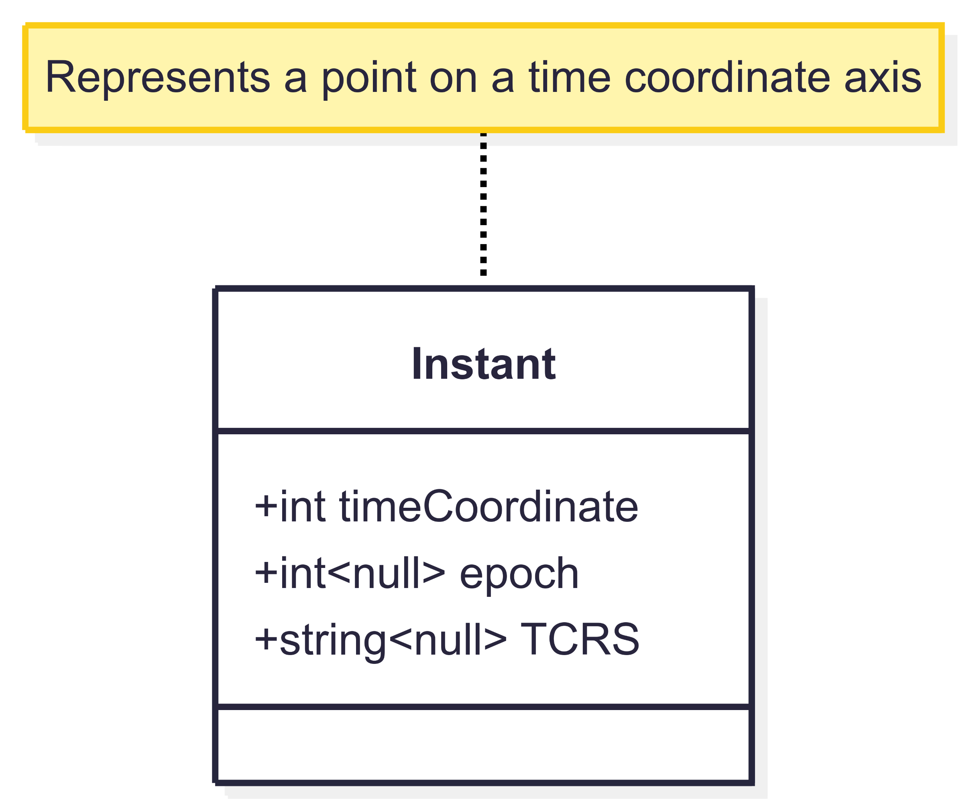
Time Coordinate - Instant

Slide 33
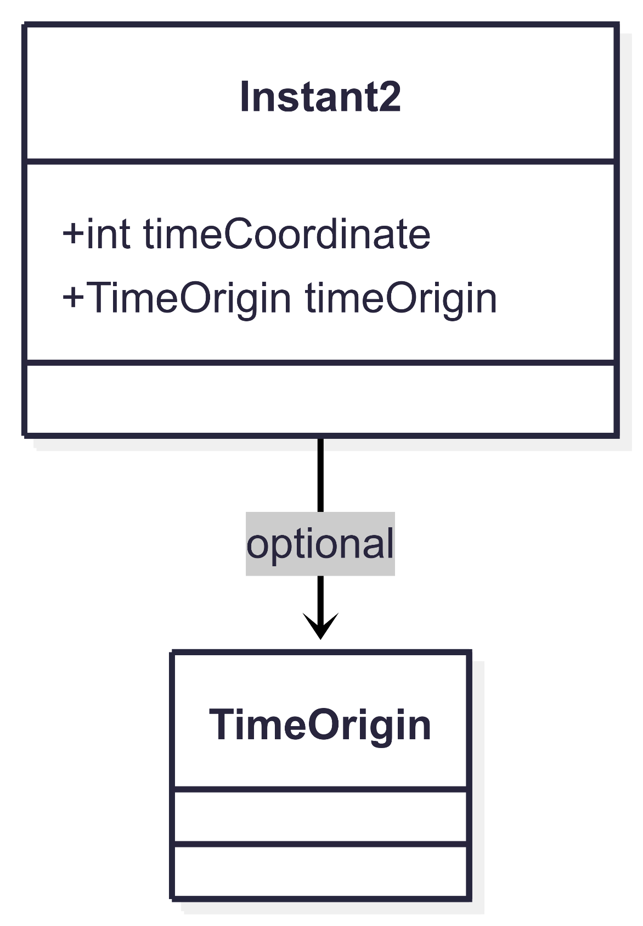
Time Coordinate – Instant2

Slide 34
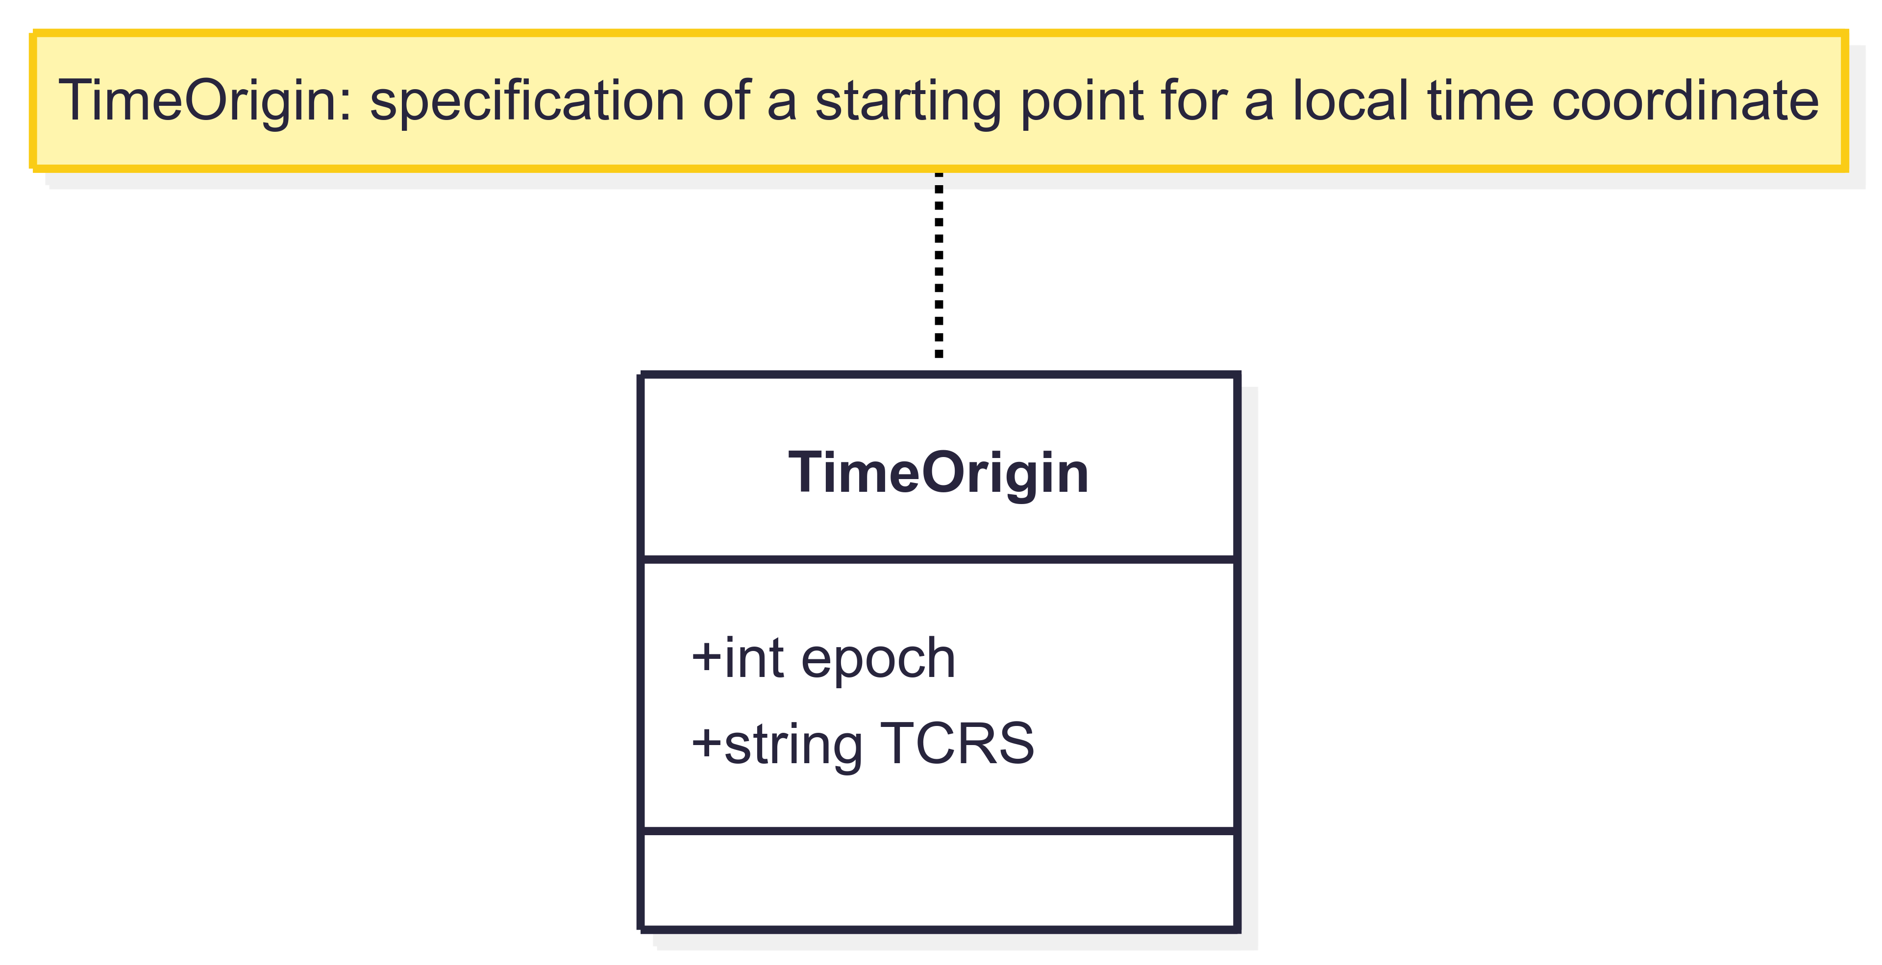
Time Coordinate – TimeOrigin

Slide 35
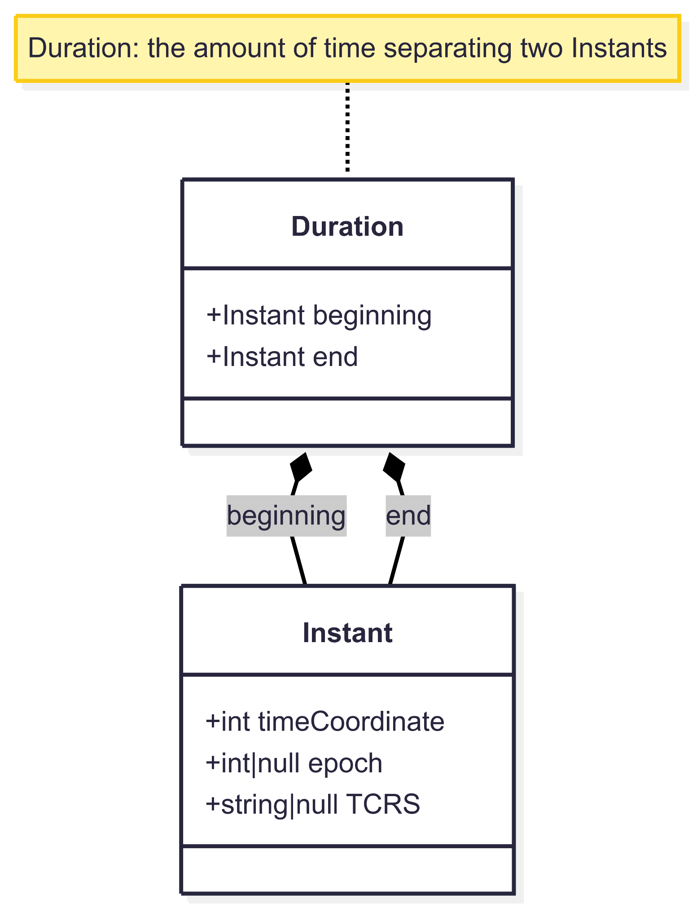
Time Coordinate - Duration

Slide 36
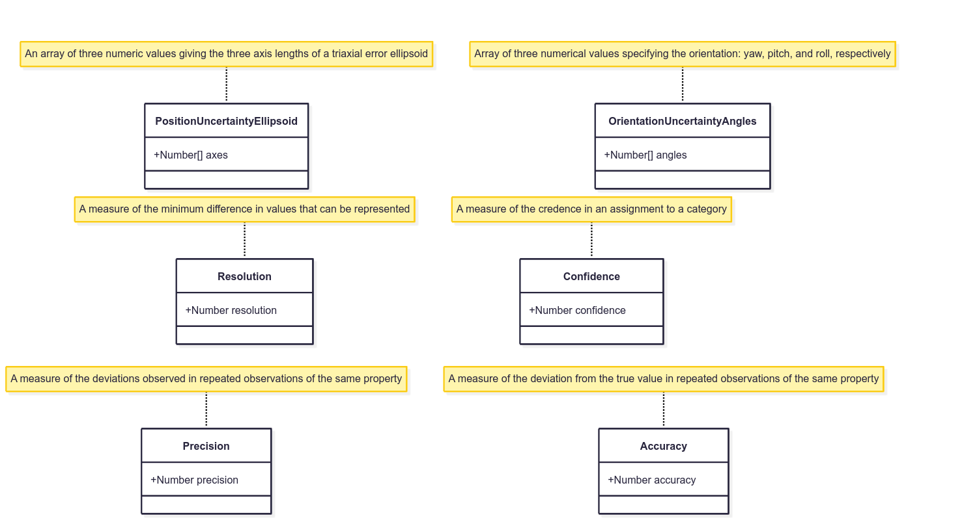
Uncertainty Components
2:40

Slide 37
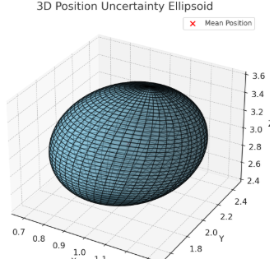
Uncertainty Components – PositionUncertaintyEllipsoid
A 3D position uncertainty ellipsoid, visualizes the spread and orientation of uncertainty around a central point in space. The red dot indicates the mean (expected) position, and the ellipsoid's shape and orientation are derived from the covariance matrix, representing positional variance in all directions.

Slide 38
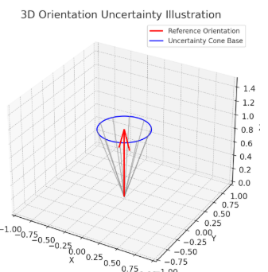
Uncertainty Components – OrientationUncertaintyAngles
Here is a 3D illustration of orientation uncertainty. The red arrow represents the reference orientation, and the blue circle and gray lines form a cone showing possible deviations within a 20-degree uncertainty range. This captures the idea that the orientation could point in any direction within the cone’s spread.

Slide 39
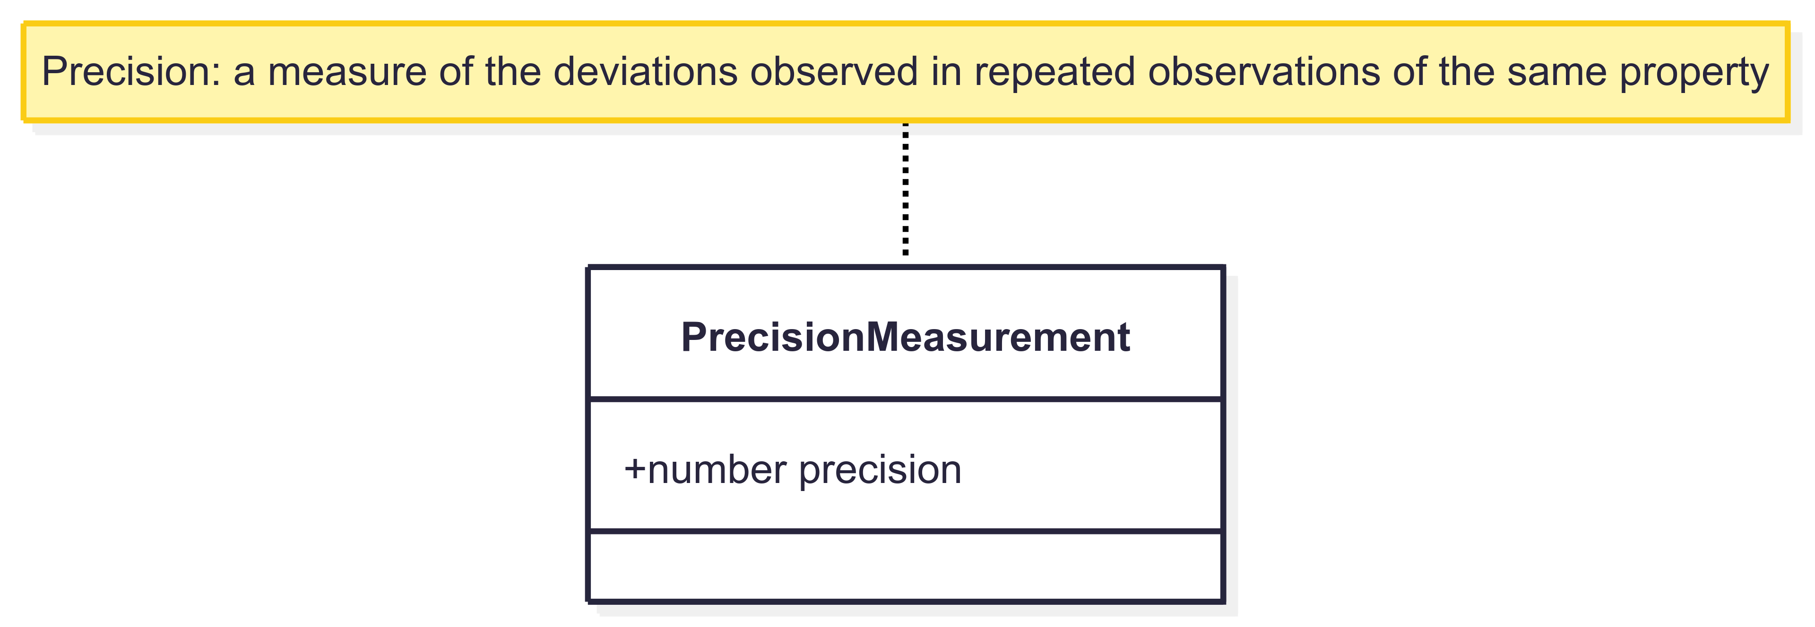
Uncertainty Components – Precision

Slide 40
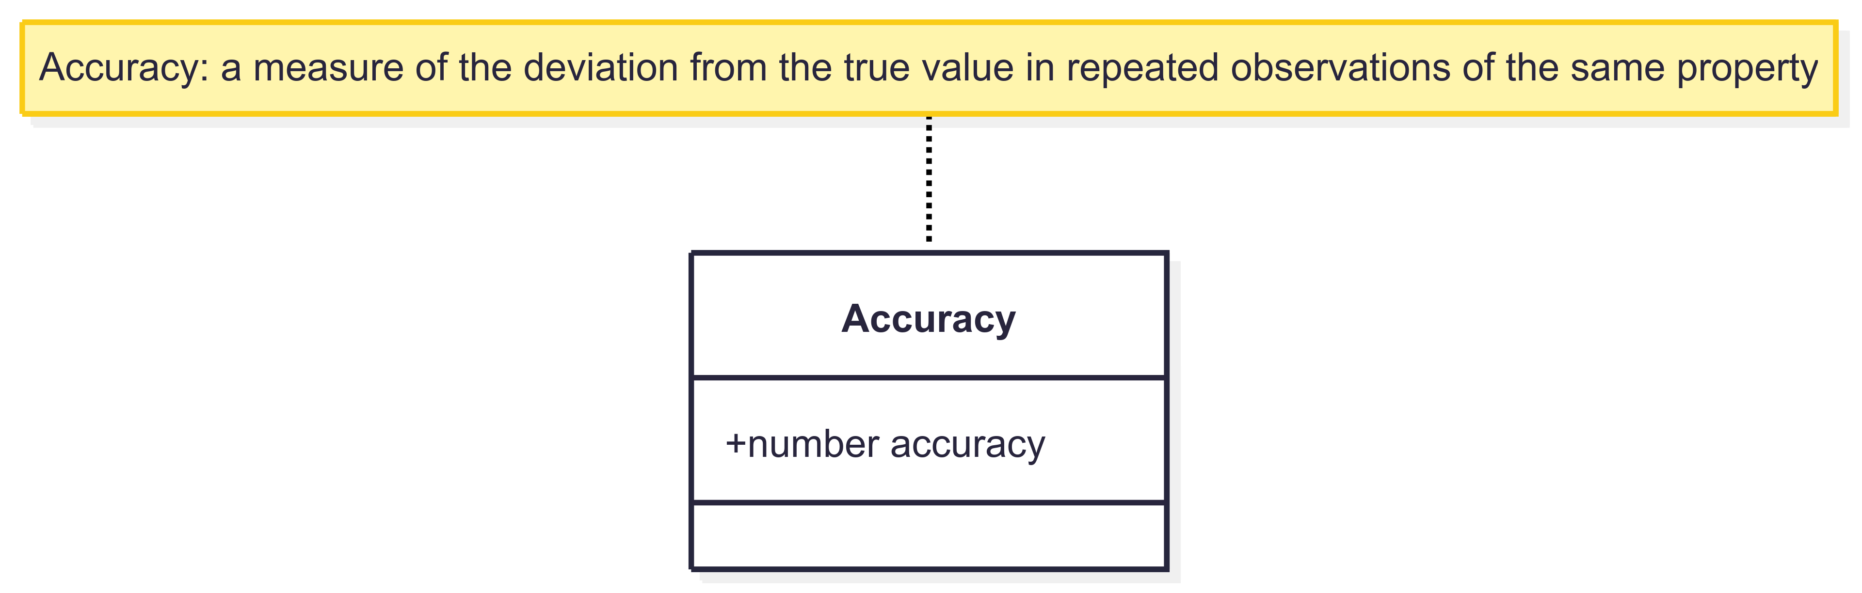
Uncertainty Components – Accuracy

Slide 41
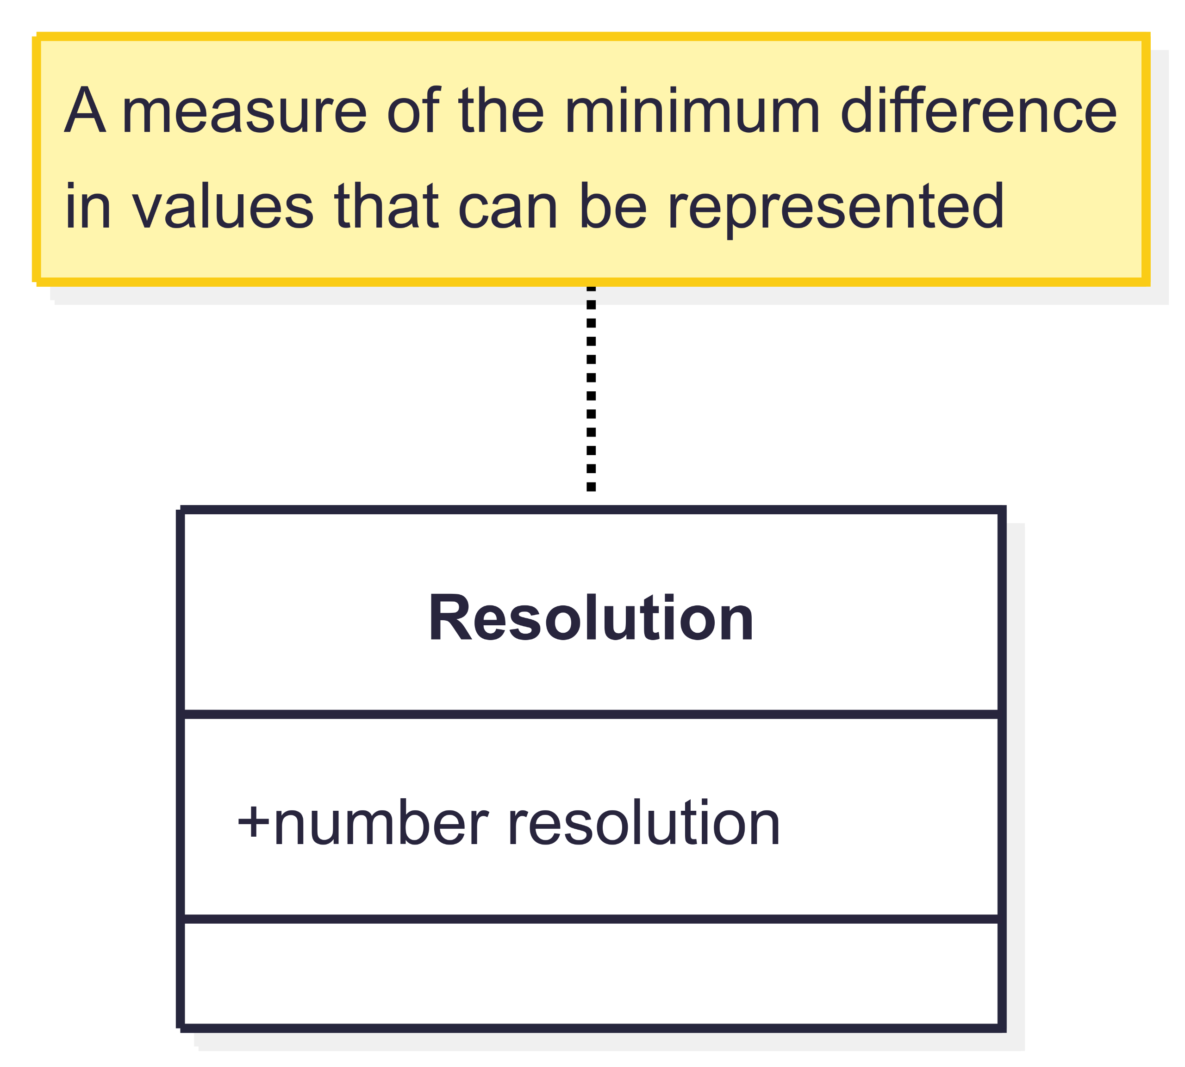
Uncertainty Components – Resolution

Slide 42
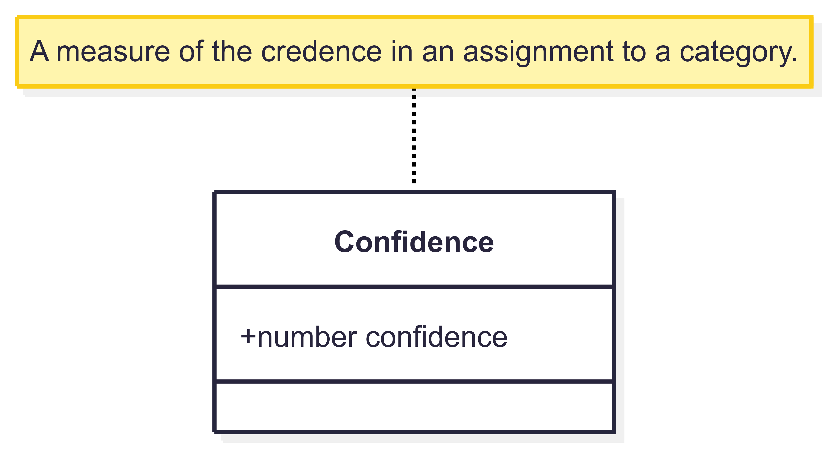
Uncertainty Components – Confidence

Slide 43
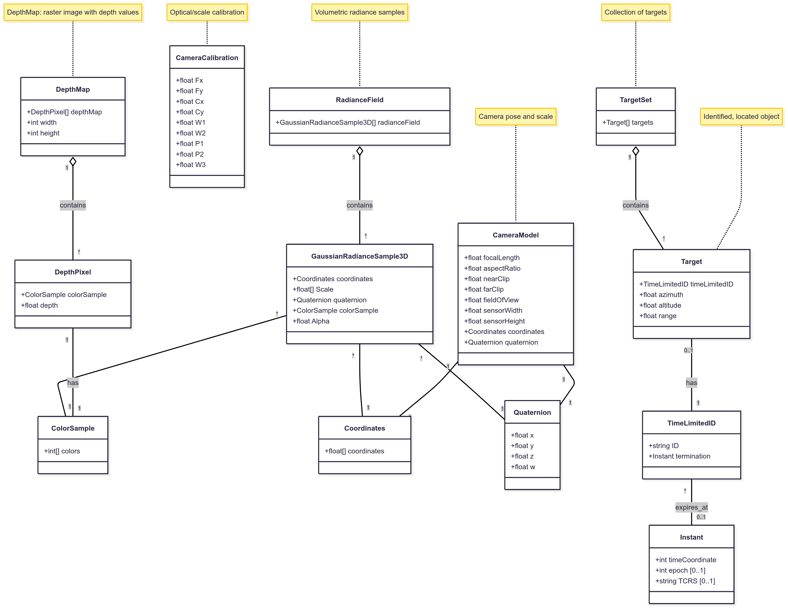
Image Element Components
2:30

Slide 44
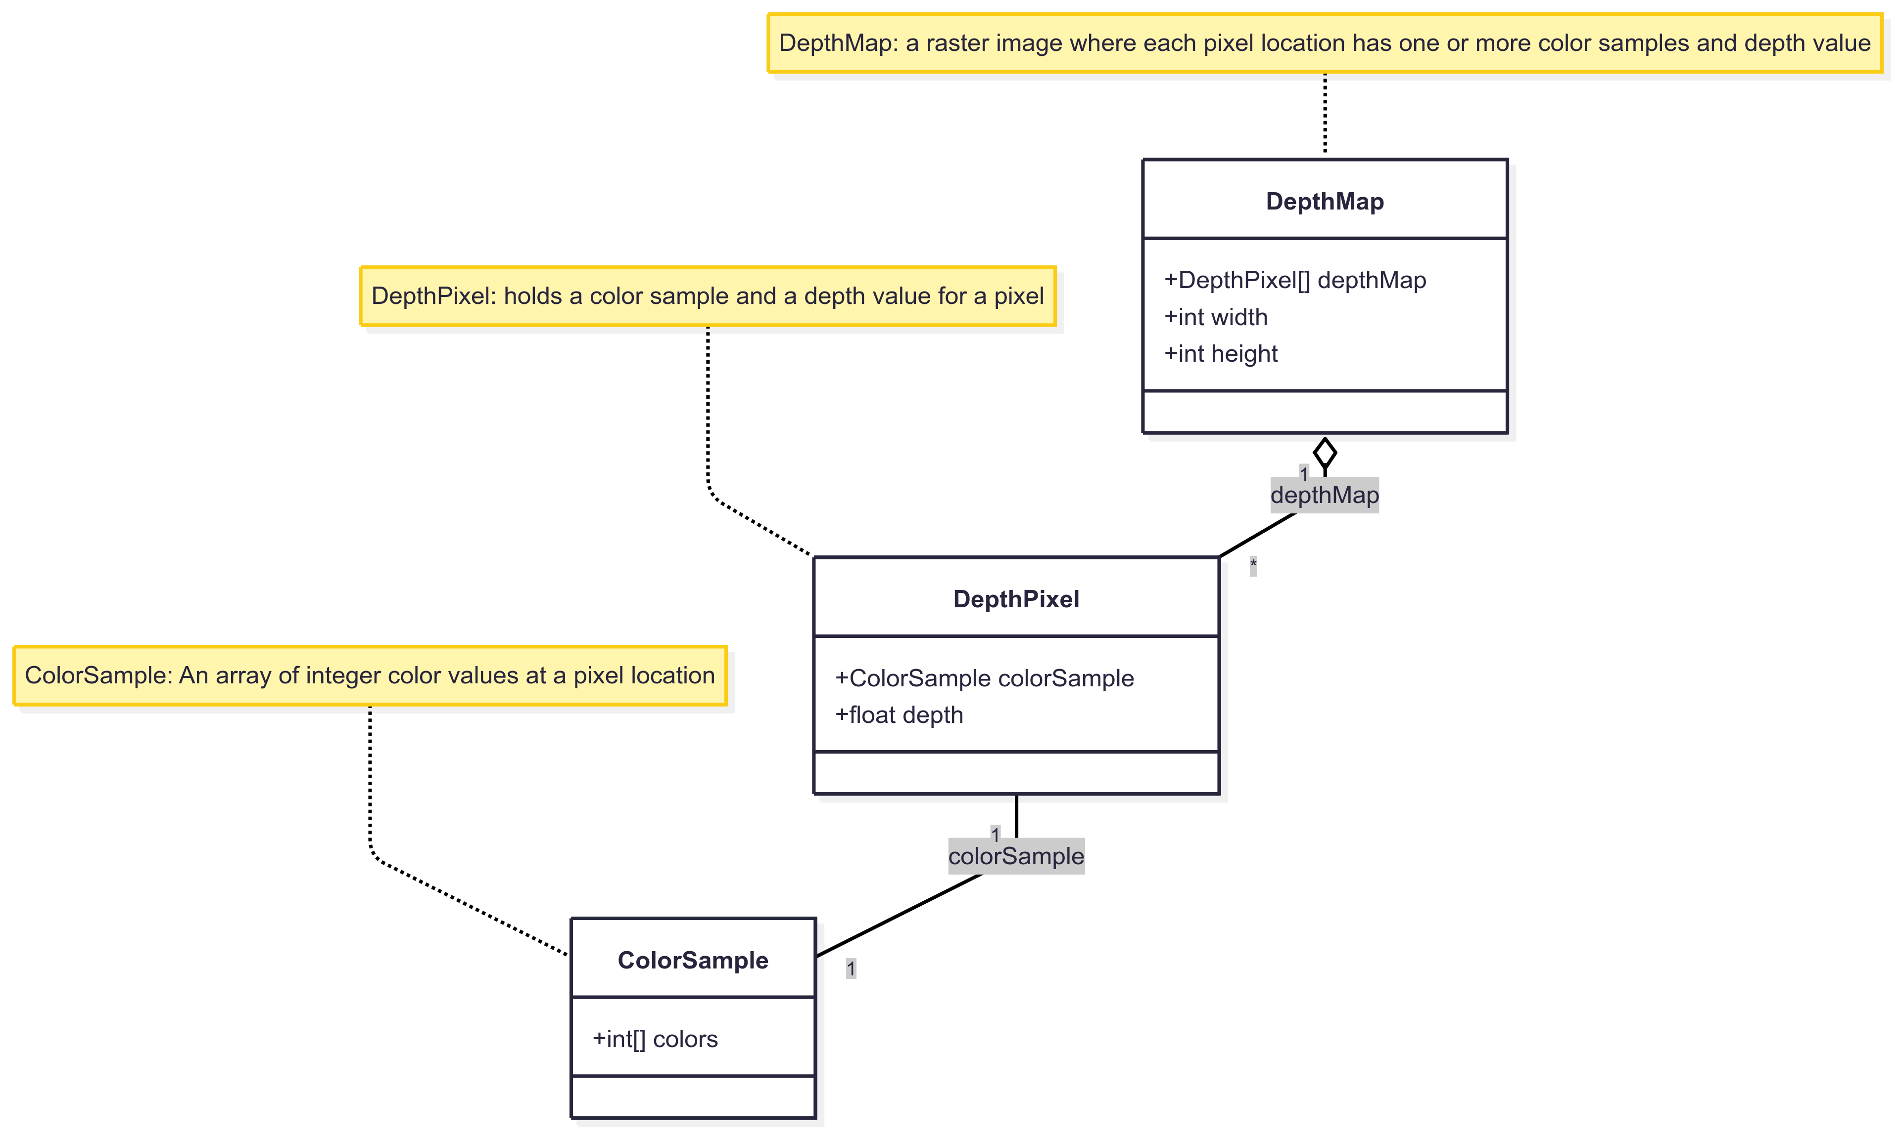
Image Element Components – DepthMap

Slide 45
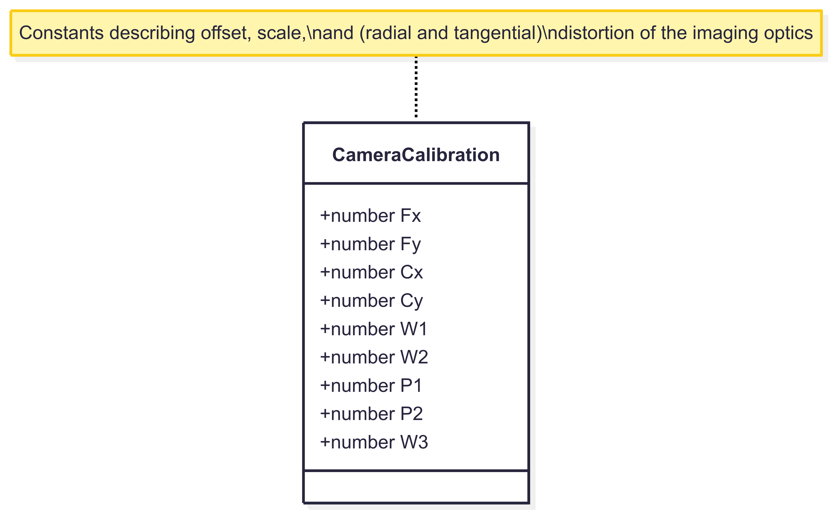
Image Element Components – CameraCalibration

Slide 46
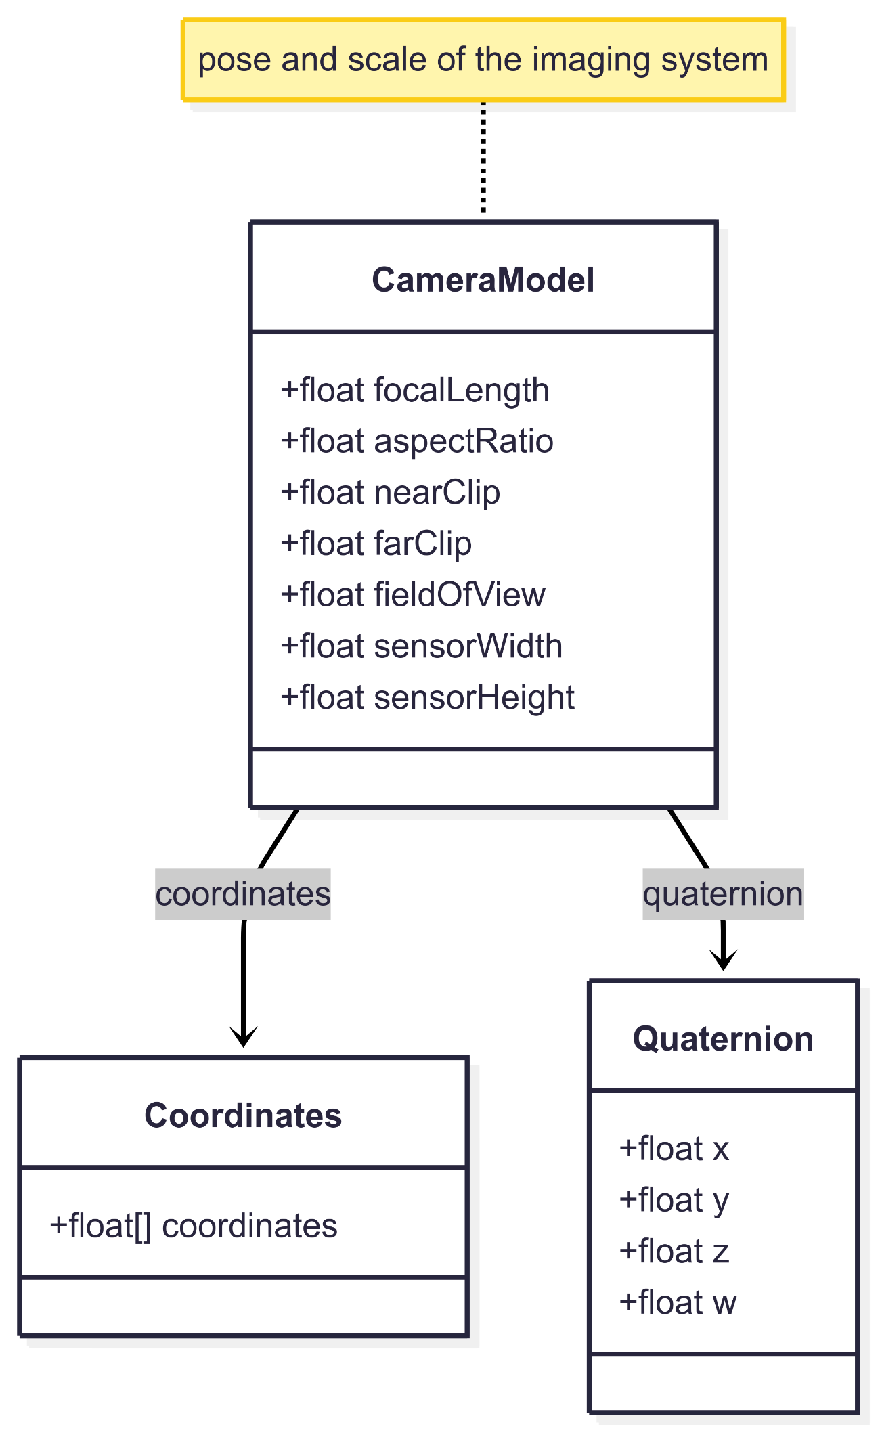
Image Element Components – CameraModel

Slide 47
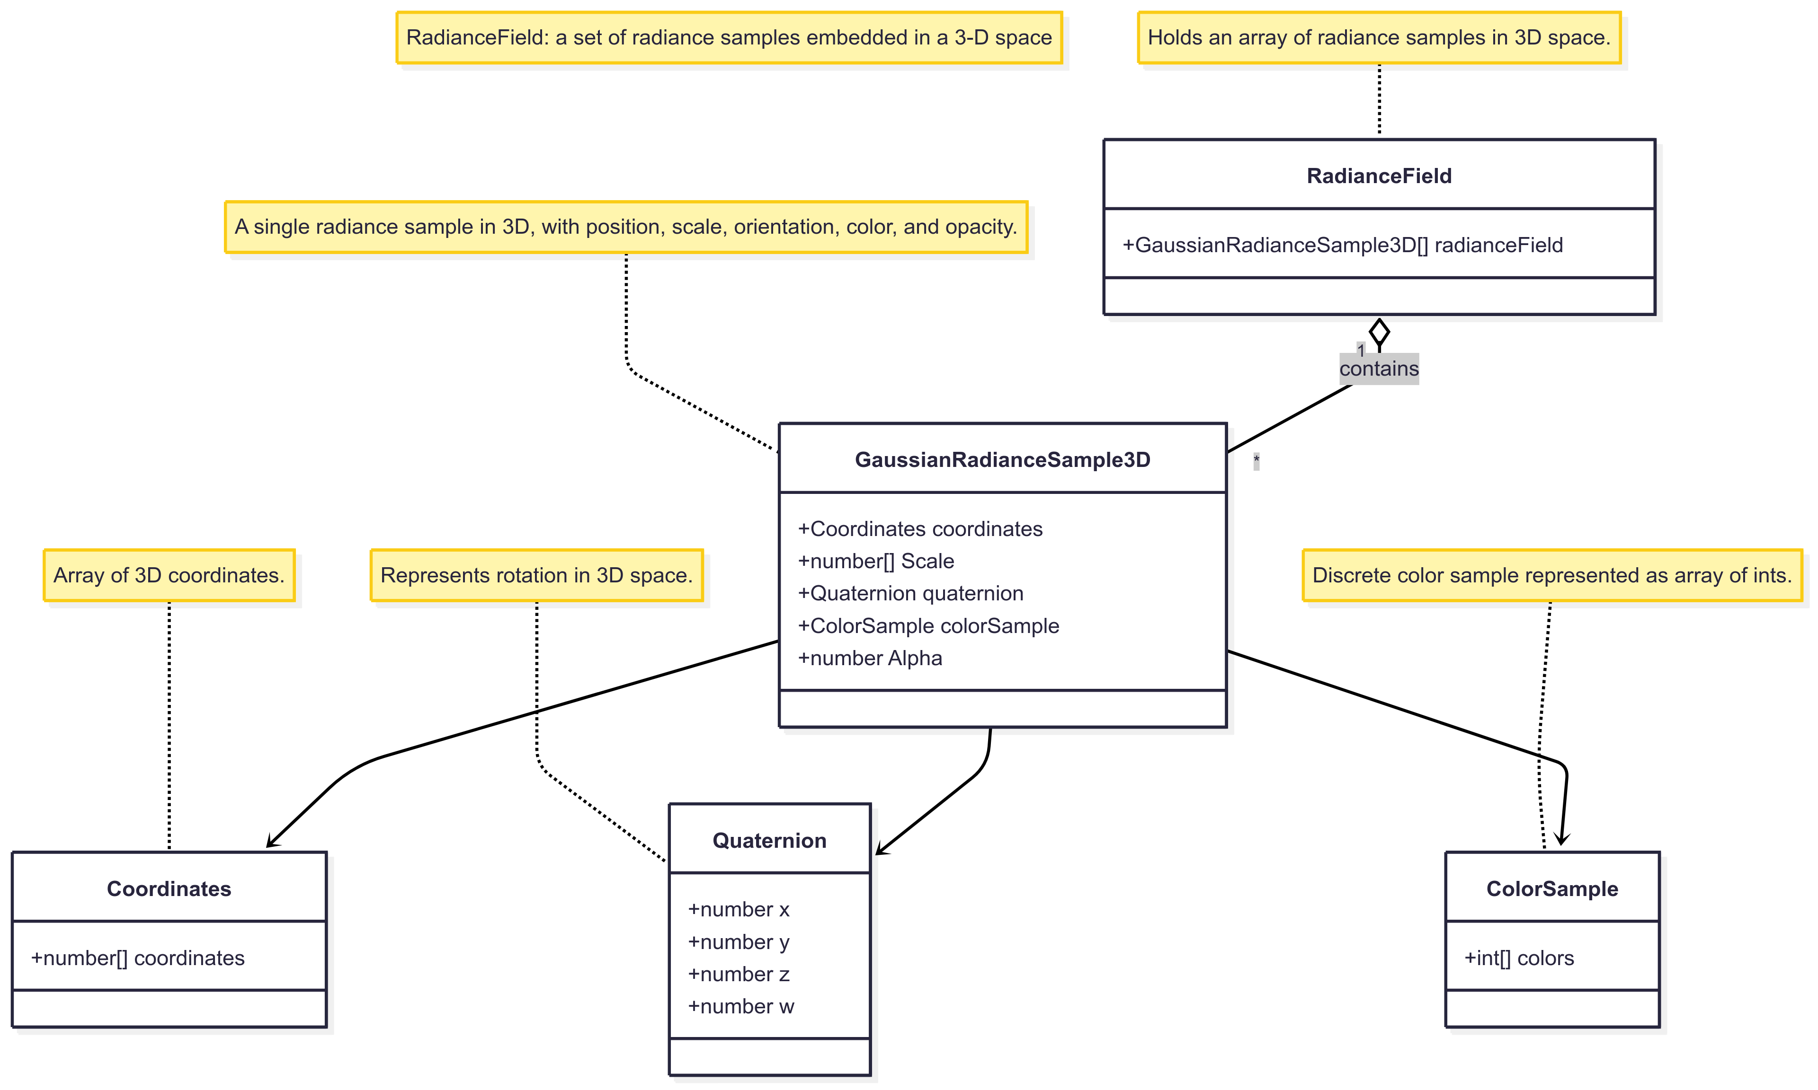
Image Element Components – RadianceField

Slide 48
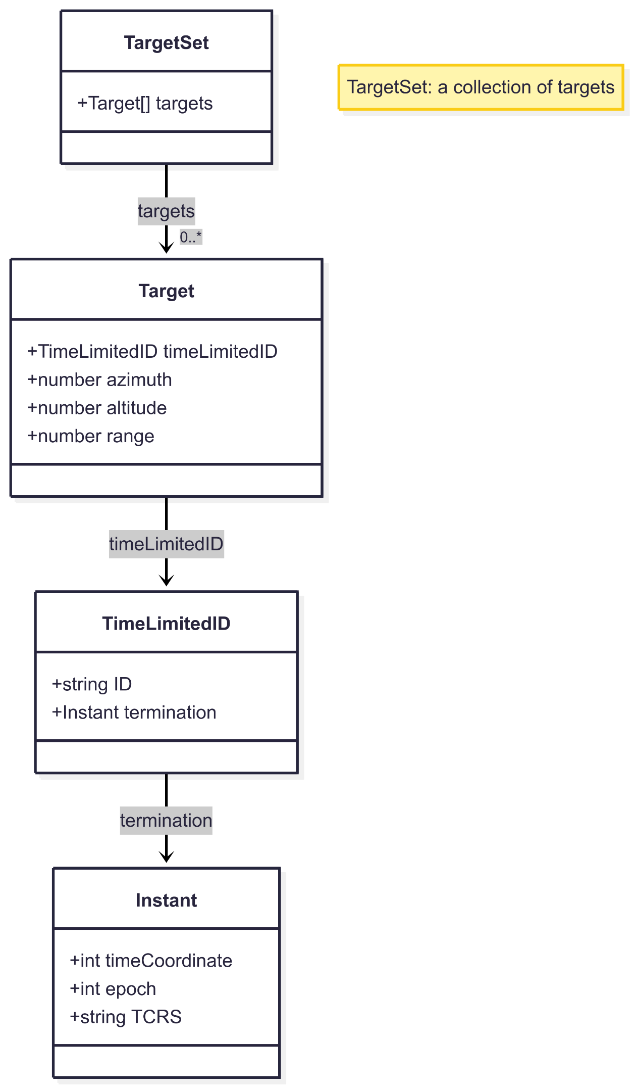
Image Element Components – TargetSet

Slide 49
Back to Now
Following the initial public review and subsequent publication of the GeoPose standard, we received valuable feedback across multiple areas. These insights were carefully analyzed and grouped into eight focused work packages—each centered around a specific theme—to guide future enhancements and ensure the standard continues to meet the needs of its growing user community.
Origins slides
Work package slides
Intro 1
Table 2
WP-by-WP slides 8
Detail for components +12
Details for MSF VPS support +5
Roadmap 3 slides

Slide 50
Roadmap
Go back to the Work Package table
Currently no leader for or work planned for Disrupted, Denied, Intermittent, and Limited (DDIL) encoding.
WP 8 is being prototyped now (Q4 2025) and results will feed back into WP8 in Q1 2026.
If you are interested of potentially affected by any of the WPs, please consider joining or leading.
Thank you.

Slide 51
Further Questions, Comments?

Slide 52


THANK YOU
www.ogc.org
https://metaverse-standards.org/

